Slide 1
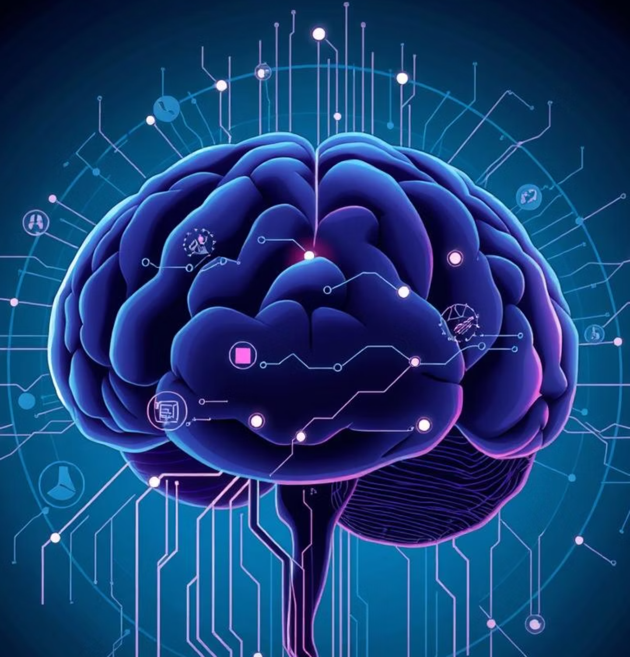
RAG-Enabled Workflow Automation for MRI Brain Tumor Classification Using Transfer Learning
Muhammad Ramish Ali School of electrical engineering and Computer Sciences(Seecs) Nust

Slide 2

Problem & Objective: Enhancing Brain Tumor Diagnosis
Clinical Challenge
Traditional MRI-based brain tumor diagnosis is a manual, time-consuming process heavily reliant on specialist radiologists. Misclassification or delays can severely impact treatment planning and patient outcomes. The subjective nature of visual interpretation also introduces variability.
Technical Gap
Many machine learning projects often conclude with a Jupyter notebook demonstrating accuracy metrics. Few, however, progress to deliver a complete, explainable, and deployable pipeline capable of real-world application. Bridging this gap is crucial for clinical integration.
Project Objective
To develop a comprehensive, MS-level ML pipeline for brain tumor classification. This includes data acquisition, preprocessing, model development, rigorous evaluation, and robust deployment. The goal is high accuracy combined with a user-friendly web/API interface for clinical decision support.

Slide 3
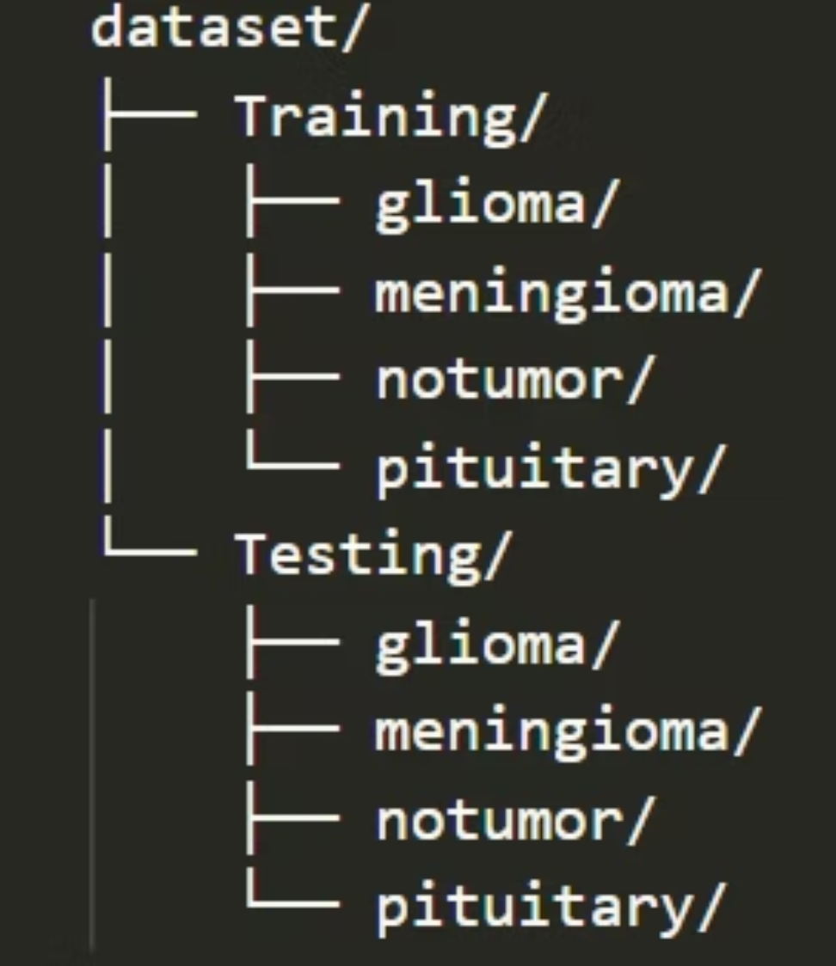
Dataset & Preprocessing: Building a Robust Foundation
Resizing:
Each image is uniformly resized to 224 × 224 pixels and converted to RGB, ensuring consistent input dimensions for the model.
Normalization:
Images are normalized using EfficientNet ’s preprocess_input function, scaling pixel values to the expected range for the pre-trained model.
Augmentation:
On-the-fly augmentation techniques, including random flips, small rotations, and zooms, are applied to improve model generalization and reduce overfitting.
Data Pipelining:
TensorFlow data pipelines and generators are employed for efficient batching and prefetching, optimizing GPU utilization during training.
Preprocessing Steps
Our dataset is organized into Training/ and Testing/ folders, each containing four subfolders: glioma/ , meningioma/ , notumor/ , and pituitary/ .
Comprising approximately 7,000 MRI images

Slide 4
Model Architecture: EfficientNet + Transformer Hybrid
EfficientNetB0 Base Utilizes EfficientNetB0 from tensorflow.keras.applications , pre-trained on ImageNet. This provides a powerful foundation for extracting rich 2D feature maps from MRI slices, capturing low-level and mid-level visual representations.
Transformer-Enhanced Head Applies Global Average Pooling or flattening to convolutional features, creating a compact embedding. This is then fed into one or more Transformer encoder blocks (multi-head self-attention + feed-forward) to capture long-range dependencies.
Final Dense Layers The Transformer output is processed by a 128-unit ReLU layer with Dropout, followed by a Dense layer with 4 units and softmax activation to produce class probabilities for glioma, meningioma, pituitary, and no tumor.

Slide 5
Training Pipeline Phase 1:
The EfficientNetB0 backbone is initially frozen, and only the newly added classification head is trained. This allows the model to adapt the top layers to the specific task without disturbing the pre-trained feature extractor. Phase 2:
Selected top layers of the EfficientNetB0 backbone are unfrozen and fine-tuned with a significantly lower learning rate. This enables the model to subtly adjust its foundational feature extraction capabilities for the brain MRI dataset.
Core Settings (TensorFlow/Keras) Optimizer:
Adam is used with distinct learning rates for initial training and fine-tuning phases. Loss Function: sparse_categorical_crossentropy is employed. Batch Size: Optimized to efficiently utilize GPU memory while maintaining stable gradient estimates. Callbacks: Early stopping and learning rate reduction callbacks are implemented, triggered by monitoring validation loss, preventing overfitting and accelerating convergence.
Effect of Tuning The combination of data augmentation and phased fine-tuning significantly improved validation accuracy and mitigated overfitting, outperforming a naive, frozen-backbone baseline.
Training Strategy & Hyperparameters

Slide 6
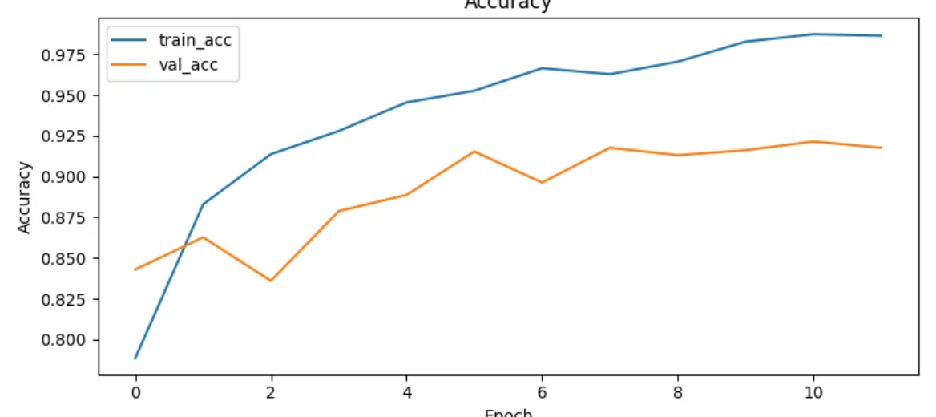
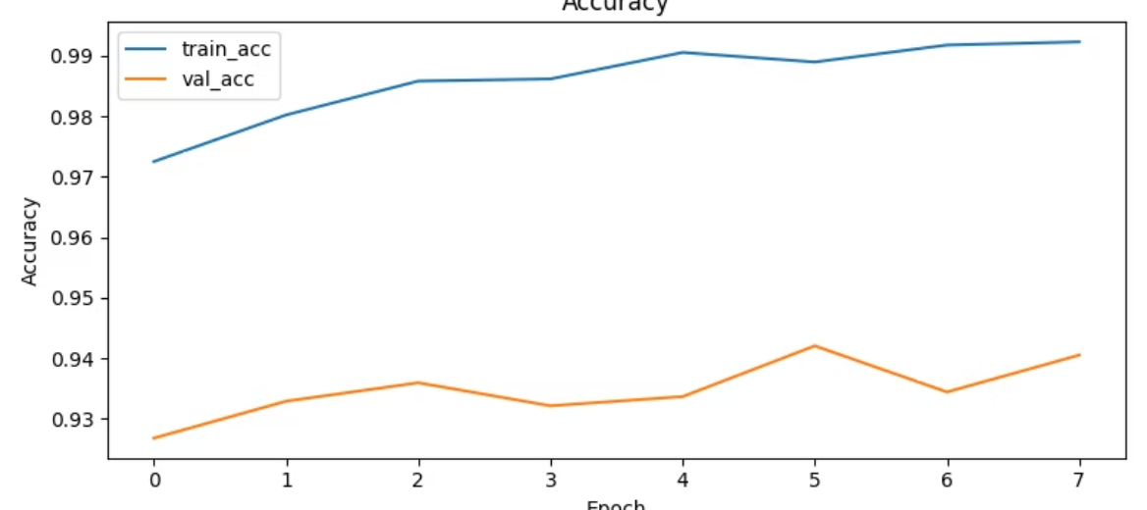
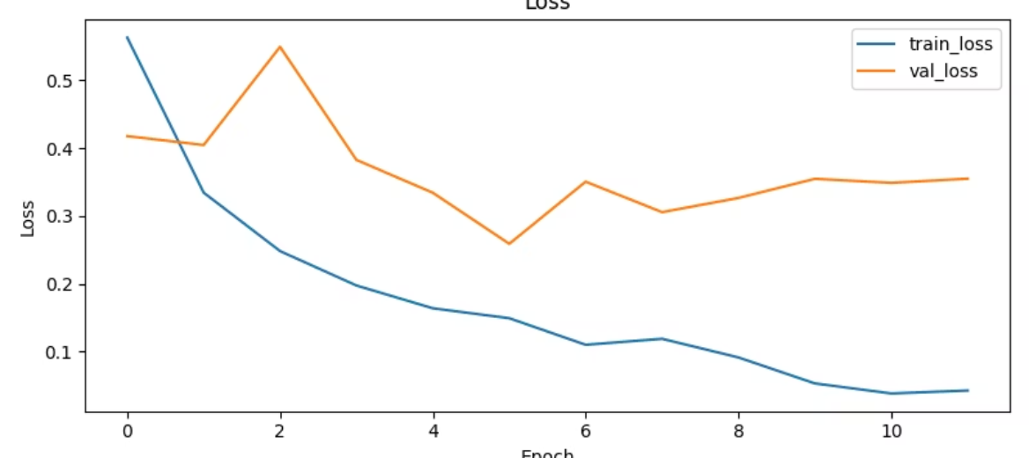
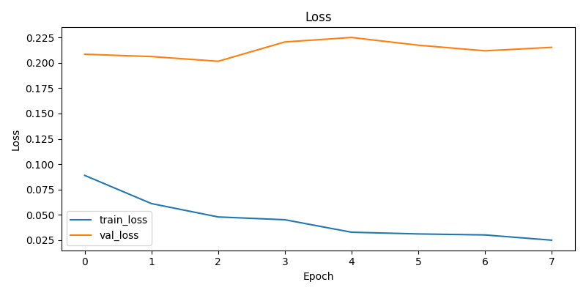
Training Curves: Accuracy & Loss Progression
Phase 1 (Baseline Training)
Training accuracy rose from ~0.79 to ~0.98, while validation accuracy improved from mid-0.80s to ~0.92 over ~11 epochs. Loss dropped steadily without significant divergence.
Phase 2 (Fine-Tuning)
Training accuracy saturated near 0.99, and validation accuracy stabilized around 0.93–0.94. Validation loss remained low (~0.20–0.22) without signs of overfitting.
Key Takeaways
Smooth, monotonic improvements and a minimal train–validation gap indicate strong generalization. Fine-tuning refined performance from "good" to "very strong," confirming the strategy's effectiveness.

Slide 7
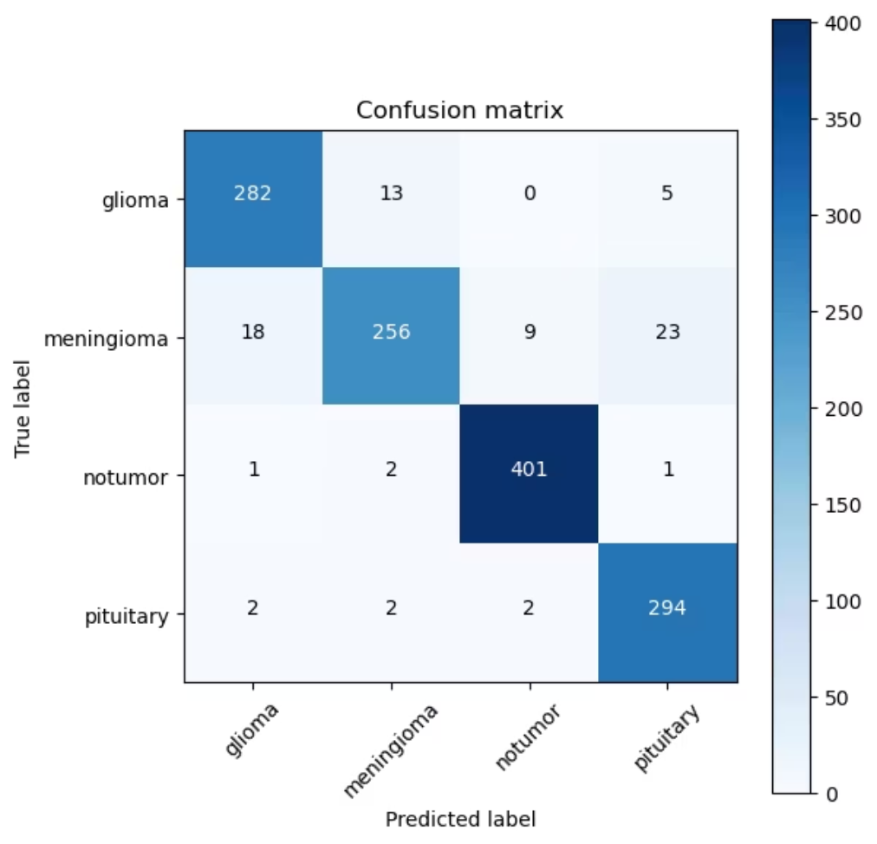
Evaluation & Metrics: Final Confusion Matrix
Overall test accuracy: ≈ 94% (1233 / 1311).
Macro Precision/Recall/F1: All ≈ 0.94 , indicating
balanced performance across classes.
Interpretation: Strong diagonal dominance confirms consistent predictions. Crucially, "tumor vs no-tumor" misclassifications are rare, highlighting clinical safety. Most errors occur between tumor subtypes, a common challenge in medical imaging.

Slide 8
Explainability with Grad-CAM: Illuminating Model Decisions
Implementation Details
Layer Selection: A dedicated convolutional layer (gradcam_target_conv) is chosen from the loaded Keras model for Grad-CAM generation.
Gradient Computation: A mini tf.keras.Model is constructed to output both feature maps and final predictions. tf.GradientTape then computes gradients of the predicted class score with respect to the feature maps.
Heatmap Generation: Gradients are processed with ReLU and normalization to produce a clear heatmap.
System Integration & Outcome The Flask API returns a base64-encoded Grad-CAM overlay, which is then displayed on the web dashboard alongside the original MRI. This allows medical professionals to visually confirm where the model is focusing its attention during classification.

Slide 9
Deployment: Flask API + Medical Dashboard
Flask REST API (flask_api_server.py)
The core of our deployment is a robust Flask REST API, designed for seamless interaction with the trained model
Model Loading: Loads the final Keras model from results/models/final_model.keras , ensuring fallbacks for resilience.
.
Front-End (medical_dashboard.html)
A modern HTML/CSS dashboard provides an intuitive user interface for clinical use:
User-Friendly Design: Features a drag-and-drop upload mechanism, patient information form, and scan date input.
API Interaction: Calls the Flask API via JavaScript to retrieve predictions and explanations.
Visualizations: Displays the primary diagnosis with a confidence bar, a detailed per-class probability table, and the crucial Grad-CAM heatmap overlay.
Reporting: Supports PDF export of comprehensive reports using html2canvas and jsPDF , facilitating integration into clinical documentation workflows.
/predict Endpoint:
Decodes and preprocesses images (resize + EfficientNet preprocessing).
Runs the classification model, returning class probabilities.
Generates and includes the Grad-CAM image in the response.
Returns a JSON object with predicted class, confidence, probability vector, Grad-CAM, model version, and timestamp.
/health Endpoint: Provides system status, including whether the model is successfully loaded and ready for inference.

Slide 10
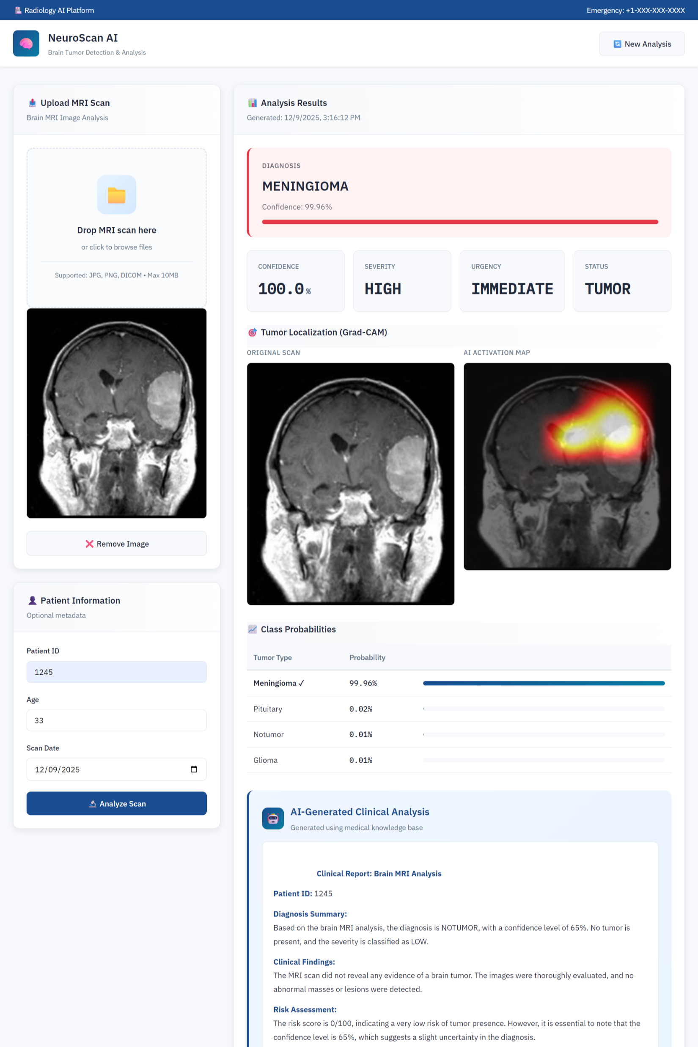
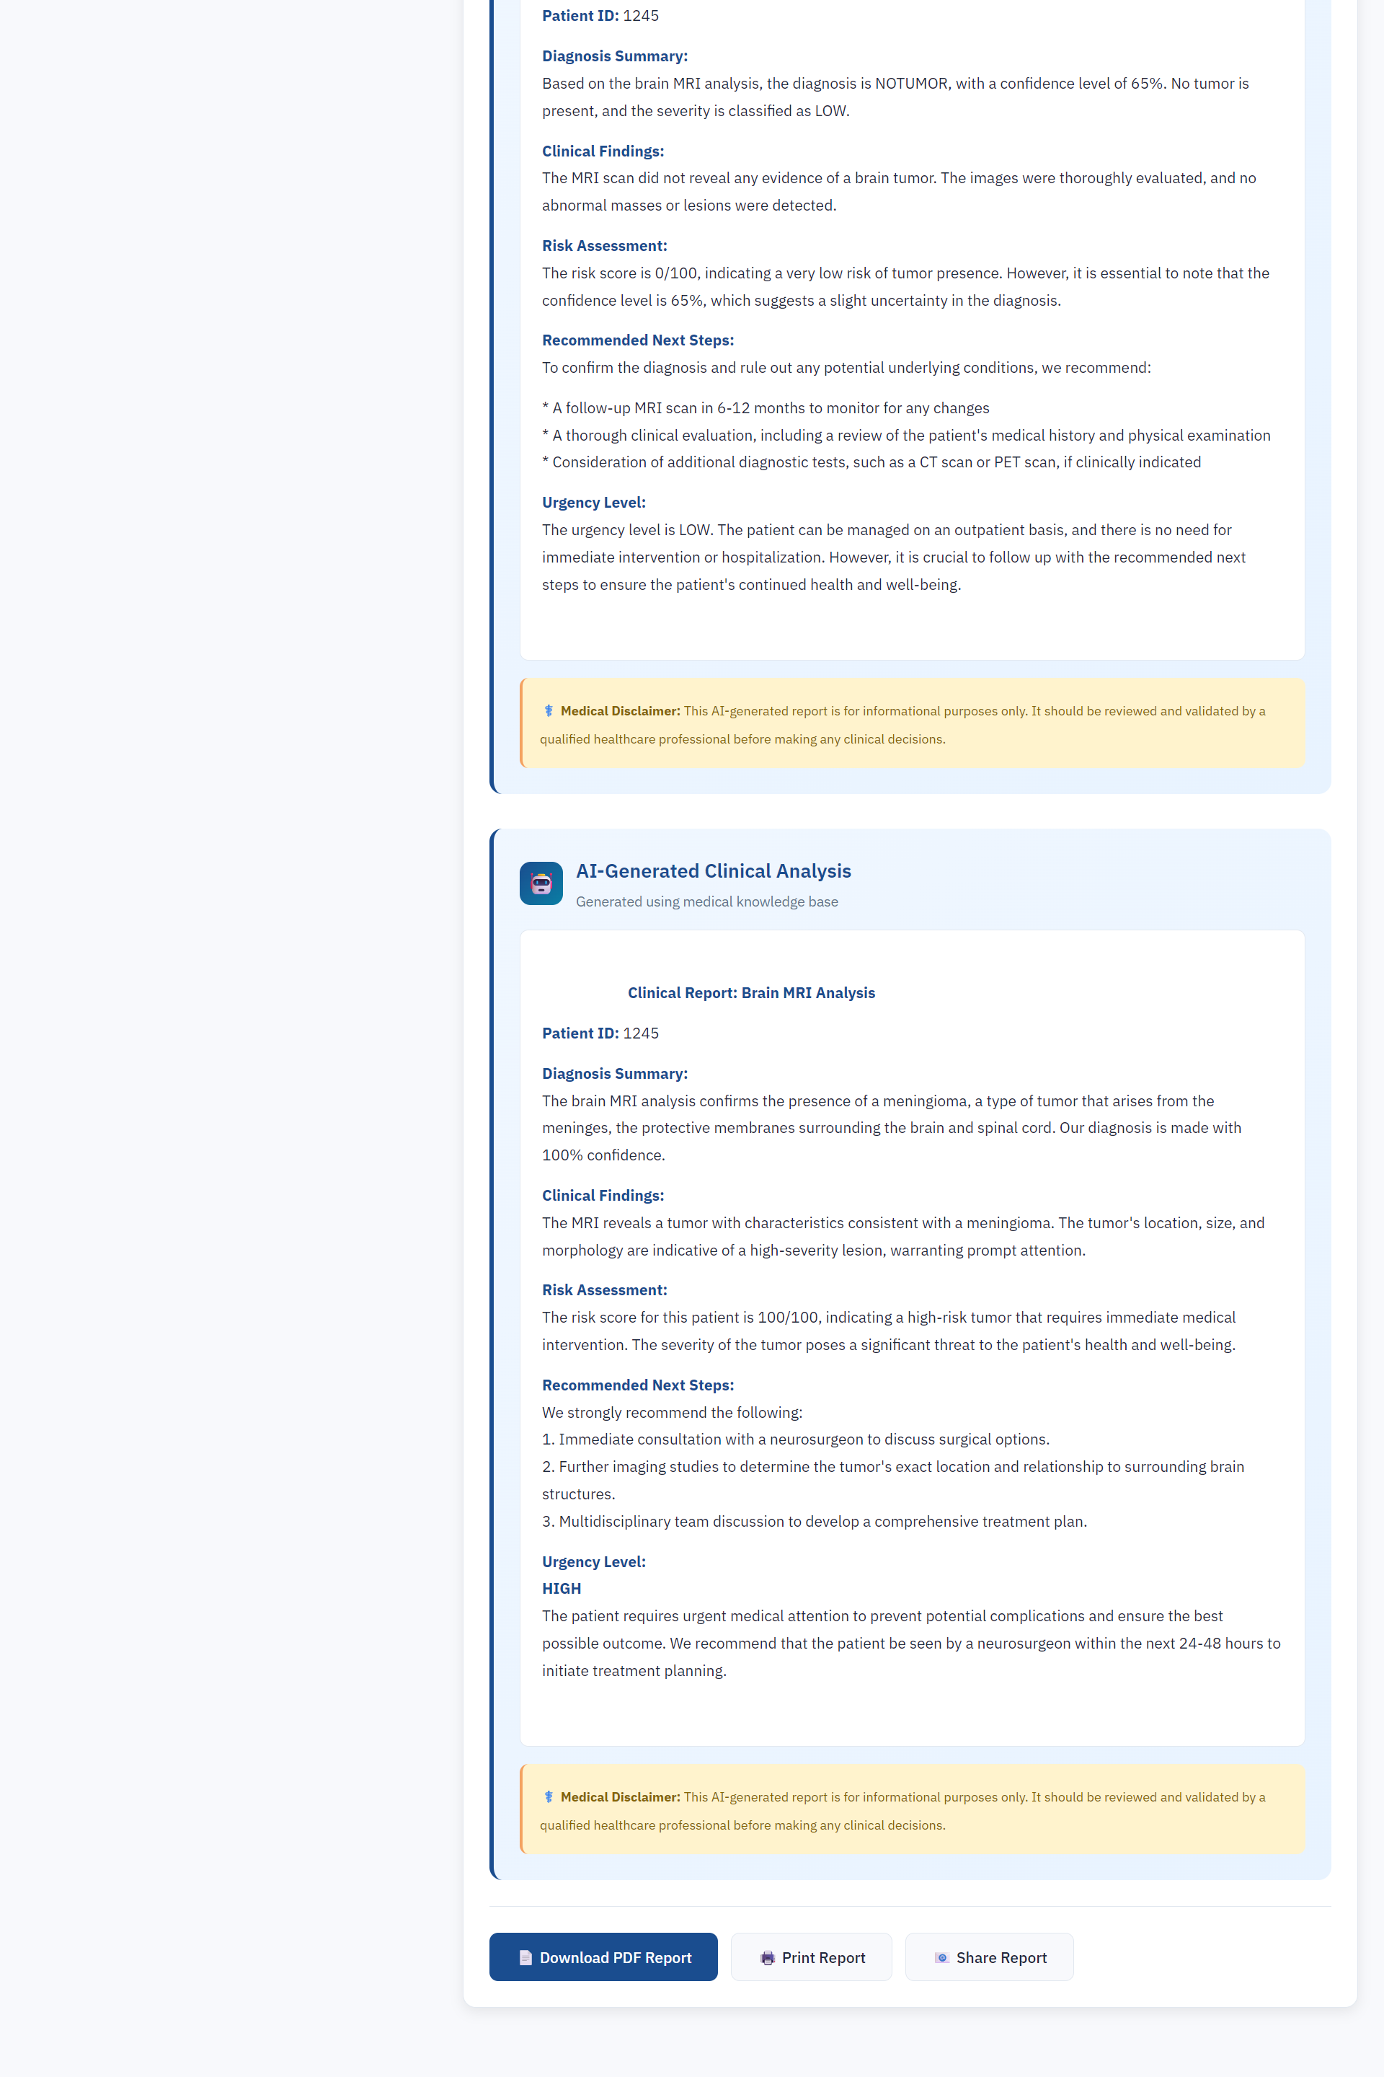
Web Interface:

Slide 11
N8N Workflow & Groq LLM Integration
Webhook – Receive MRI Image
Extract & Validate Image
Brain Tumor Model Prediction
Entry point for accepting MRI images or URLs, along with patient metadata.
JavaScript node normalizes payload and ensures valid image data for processing.
HTTP node calls the Flask /predict endpoint for AI classification.
Parse & Enrich Results
Build RAG Context
Groq LLM – Generate Report
Computes severity, risk scores, and flags high-risk glioma cases.
Constructs a detailed prompt with probabilities, severity, and similar historical cases.
Utilizes a free Groq LLM to produce a structured, clinical-style narrative report.
Format Final Response & Alerts
Formats the JSON response and optionally sends email alerts for high-severity cases
.
.

Slide 12
Limitations
Trained on a single public dataset; not yet clinically validated across multiple hospitals.
2D slice-based model; does not exploit full 3D MRI volumes or multi-sequence inputs. Real-time inference depends on available GPU/CPU resources.
Future Work
Extend training to 3D or multi-sequence MRI and larger, more diverse datasets.
Explore lighter or quantized versions of the model for edge deployment.
Add additional XAI methods and rigorous calibration/uncertainty estimation.
Harden the N8N pipeline (authentication, logging, monitoring) for production use.
Key Takeaway This project goes beyond a single notebook: it delivers a complete, explainable ML pipeline—with real metrics, an API, a web dashboard, and workflow automation—showing how MS-level research can translate into a realistic, end-to-end medical AI prototype.
Limitations, Future Work, & Key Takeaways

Slide 13

End

